Slide 1



Noida Institute of Engineering and Technology, Greater Noida
Problem solving using Advanced Python
(ACSE0101/AMICSE0101)
UNIT-V
Libraries in Python
B. Tech Second Semester
(Common to multiple branches)

Slide 2
Index
Course Outcomes
Syllabus
Contents of the Unit
Objectives of the Unit
CO- PO correlation w.r.t. Unit
CO-PSO correlation w.r.t. Unit
Objectives of the topic
Topic mapping with CO
Video Links
Daily Quiz
MCQs
Weekly assignment
Old University Exam Paper
Expected Questions for University Exams
Summary
References

Slide 3
Course Outcome
Course Outcome ( CO) | At the end of course , the student will be able to: | Bloom’s Knowledge Level (KL)
CO1 | Define classes and create instances in python. | K1, K2
CO2 | Implement concept of inheritance and polymorphism using python. | K3
CO3 | Implement functional programming in python. | K2
CO4 | Create GUI based Python application. | K3
CO5 | Apply the concept of Python libraries to solve real world problems. | K3, K6

Slide 4
Syllabus
UNIT-5
Libraries in Python
NumPy: Basic Operation, Indexing, slicing and Iterating, multidimensional arrays, NumPy Data types, Reading and writing data on Files.
Pandas : Series and Data Frames, Grouping, aggregation, Merge Data Frames, Generate summary tables, Group data into logical pieces, Manipulation of data.
SciPy: Introduction to SciPy, Create function, modules of SciPy.
Matplotlib: Scatter plot, Bar charts, histogram, Stack charts, Legend title Style, Figures and subplots, Plotting function in pandas, Labelling and arranging figures, Save plots.
Seaborn: style function, color palettes, distribution plots, category plot, regression plot.

Slide 5
Contents of the Unit
Libraries in Python
NumPy
Pandas
SciPy
Matplotlib
Seaborn

Slide 6
Objectives of the Unit
After completion of this unit, student will be able to:
Learn various useful libraries available in Python.
Explore the knowledge of standard Python libraries.
Store data in the form of arrays using numpy library.
Visualise the data and will be able to know about data distribution using Matplotlib and Seaborn libraries.

Slide 7
CO-PO Correlation Matrix
CO.K | PO1 | PO2 | PO3 | PO4 | PO5 | PO6 | PO7 | PO8 | PO9 | PO10 | PO11 | PO12
CO1 | 3 | 3 | 3 | 3 | 2 | 2 | 1 | - | 1 | - | 2 | 2
CO2 | 3 | 3 | 3 | 3 | 2 | 2 | 1 | - | 1 | 1 | 2 | 2
CO3 | 3 | 3 | 3 | 3 | 3 | 2 | 2 | - | 2 | 1 | 2 | 3
CO4 | 3 | 3 | 3 | 3 | 3 | 2 | 2 | 1 | 2 | 1 | 2 | 3
CO5 | 3 | 3 | 3 | 3 | 3 | 2 | 2 | 1 | 2 | 1 | 2 | 2
AVG | 3.0 | 3.0 | 3.0 | 3.0 | 2.6 | 2.0 | 1.6 | 0.4 | 1.6 | 0.8 | 2.0 | 2.4

Slide 8
CO-PSO correlation matrix
CO | PSO
 | PSO1 | PSO2 | PSO3 | PSO4
CO1 | 2 | 2 | 2 | 2
CO2 | 2 | 2 | 1 | 1
CO3 | 2 | 2 | 1 | 1
CO4 | 2 | 2 | 1 | 1
CO5 | 2 | 2 | 2 | 2
Average | 2 | 2 | 1.4 | 1.4

Slide 9
Objectives of the Topic
After completion of this topic, student will be able to:
Learn various useful libraries available in Python.
Explore the knowledge of standard Python libraries.
Store data in the form of arrays using numpy library.
Visualise the data and will be able to know about data distribution using Matplotlib and Seaborn libraries.

Slide 10
Libraries in Python
What is a Library?
A library is a collection of pre-combined codes that can be used iteratively to reduce the time required to code.
They are particularly useful for accessing the pre-written frequently used codes, instead of writing them from scratch every single time.
Similar to the physical libraries, these are a collection of reusable resources, which means every library has a root source.
This is the foundation behind the numerous open-source libraries available in Python.
NumPy
Pandas
Matplotlib
Scipy
Seaborn

Slide 11
NumPy
Numeric, the ancestor of NumPy, was developed by Jim Hugunin.
Another package Numarray was also developed, having some additional functionalities.
In 2005, Travis Oliphant created NumPy package by incorporating the features of Numarray into Numeric package. There are many contributors to this open source project.
NumPy relies on BLAS and LAPACK for efficient linear algebra computations.
NumPy can also be used as an efficient multi-dimensional container of generic data.
NumPy is a Python package. It stands for 'Numerical Python'. It is a library consisting of multidimensional array objects and a collection of routines for processing of array.

Slide 12
NumPy - Basic Operation
Using NumPy, a developer can perform the following operations −
Mathematical and logical operations on arrays.
Fourier transforms and routines for shape manipulation.
Operations related to linear algebra. NumPy has in-built functions for linear algebra and random number generation.

Slide 13
NumPy - Environment
Standard Python distribution doesn't come bundled with NumPy module.
A lightweight alternative is to install NumPy using popular Python package installer, pip.
pip install numpy
The best way to enable NumPy is to use an installable binary package specific to your operating system. These binaries contain full SciPy stack (inclusive of NumPy, SciPy, matplotlib, IPython, SymPy and nose packages along with core Python).

Slide 14
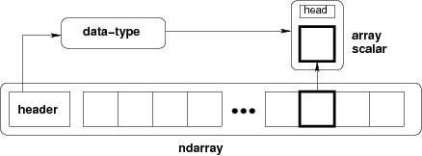
NumPy - Ndarray Object
The most important object defined in NumPy is an N-dimensional array type called ndarray. It describes the collection of items of the same type.
Items in the collection can be accessed using a zero-based index.
Every item in an ndarray takes the same size of block in the memory. Each element in ndarray is an object of data-type object (called dtype).
Any item extracted from ndarray object (by slicing) is represented by a Python object of one of array scalar types.
The following diagram shows a relationship between ndarray, data type object (dtype) and array scalar type −

Slide 15
NumPy - Ndarray Object
Example :
import numpy as np
a = np.array([1,2,3])
print (a)
# [1, 2, 3]
# more than one dimensions
import numpy as np
a = np.array([[1, 2], [3, 4]])
print (a)
# [[1, 2]
[3, 4]]
# minimum dimensions
import numpy as np
a = np.array([1, 2, 3,4,5], ndmin = 2)
print (a) # [[1, 2, 3, 4, 5]]

Slide 16
NumPy - Data Types
NumPy supports a much greater variety of numerical types than Python does.
NumPy numerical types are instances of dtype (data-type) objects, each having unique characteristics. The dtypes are available as np.bool_, np.float32, etc.
Data Type Objects (dtype)
A data type object describes interpretation of fixed block of memory corresponding to an array, depending on the following aspects −
Type of data (integer, float or Python object)
Size of data
Byte order (little-endian or big-endian)
In case of structured type, the names of fields, data type of each field and part of the memory block taken by each field.
If data type is a subarray, its shape and data type

Slide 17
NumPy - Data Types
A dtype object is constructed using the following syntax −
numpy.dtype(object, align, copy)
The parameters are −
Object − To be converted to data type object
Align − If true, adds padding to the field to make it similar to C-struct
Copy − Makes a new copy of dtype object. If false, the result is reference to builtin data type object
Example
# using array-scalar type
import numpy as np
dt = np.dtype(np.int32)
print (dt)
# int32

Slide 18
NumPy - Data Types
#int8, int16, int32, int64 can be replaced by equivalent string 'i1', 'i2','i4', etc.
import numpy as np
dt = np.dtype('i4’)
print (dt)
# int32
# using endian notation
import numpy as np
dt = np.dtype('>i4’)
print (dt)
# >i4

Slide 19
NumPy - Data Types
# first create structured data type
import numpy as np
dt = np.dtype([('age',np.int8)])
print (dt)
# [('age', 'i1’)]
# now apply it to ndarray object
import numpy as np
dt = np.dtype([('age',np.int8)])
a = np.array([(10,),(20,),(30,)], dtype = dt)
print (a)
# [(10,) (20,) (30,)]

Slide 20
NumPy - Data Types
# file name can be used to access content of age column
import numpy as np
dt = np.dtype([('age',np.int8)])
a = np.array([(10,),(20,),(30,)], dtype = dt)
print (a['age’])
# [10 20 30]
The following examples define a structured data type called student with a string field 'name', an integer field 'age' and a float field 'marks'. This dtype is applied to ndarray object.
import numpy as np
student = np.dtype([('name','S20'), ('age', 'i1'), ('marks', 'f4')])
print (student)
#[('name', 'S20'), ('age', 'i1'), ('marks', '<f4')]

Slide 21
NumPy - Data Types
Each built-in data type has a character code that uniquely identifies it.
'b' − boolean
'i' − (signed) integer
'u' − unsigned integer
'f' − floating-point
'c' − complex-floating point
'm' − timedelta
'M' − datetime
'O' − (Python) objects
'S', 'a' − (byte-)string
'U' − Unicode
'V' − raw data (void)

Slide 22
NumPy - Array
The various array attributes of NumPy.
ndarray.shape
This array attribute returns a tuple consisting of array dimensions. It can also be used to resize the array.
import numpy as np
a = np.array([[1,2,3],[4,5,6]])
print (a.shape)
# (2, 3)
# this resizes the ndarray
import numpy as np
a = np.array([[1,2,3],[4,5,6]])
a.shape = (3,2)
print (a)
# [[1, 2]
[3, 4]
[5, 6]]

Slide 23
NumPy - Array
NumPy also provides a reshape function to resize an array.
import numpy as np
a = np.array([[1,2,3],[4,5,6]])
b = a.reshape(3,2)
print (b)
# [[1, 2]
[3, 4]
[5, 6]]

Slide 24
NumPy - Array
ndarray.ndim
This array attribute returns the number of array dimensions.
# an array of evenly spaced numbers
import numpy as np
a = np.arange(24)
print (a)
# [0 1 2 3 4 5 6 7 8 9 10 11 12 13 14 15 16 17 18 19 20 21 22 23]
# this is one dimensional array
import numpy as np
a = np.arange(24)
a.ndim
# now reshape it
b = a.reshape(2,4,3)
print (b)
# b is having three dimensions

Slide 25
Pandas
What is Pandas?
Pandas is a Python library used for working with data sets.
It has functions for analyzing, cleaning, exploring, and manipulating data.
The name "Pandas" has a reference to both "Panel Data", and "Python Data Analysis" and was created by Wes McKinney in 2008.

Slide 26
Pandas
Why Use Pandas?
Pandas allows us to analyze big data and make conclusions based on statistical theories.
Pandas can clean messy data sets, and make them readable and relevant.
Relevant data is very important in data science

Slide 27
Pandas
What Can Pandas Do?
Pandas gives you answers about the data. Like:
Is there a correlation between two or more columns?
What is average value?
Max value?
Min value?
Pandas are also able to delete rows that are not relevant, or contains wrong values, like empty or NULL values. This is called cleaning the data.

Slide 28
Pandas
Installation of Pandas
If you have Python and PIP already installed on a system, then installation of Pandas is very easy.
Install it using this command:
C:\Users\Your Name>pip install pandas
Import Pandas
Once Pandas is installed, import it in your applications by adding the import keyword:
import pandas

Slide 29
Pandas
Example:
import pandas
mydataset = {
'cars': ["BMW", "Volvo", "Ford"],
'passings': [3, 7, 2]
}
myvar = pandas.DataFrame(mydataset)
print(myvar)

Slide 30
Pandas
Pandas as pd
Pandas is usually imported under the pd alias.
Create an alias with the as keyword while importing:
import pandas as pd
Example:
import pandas as pd mydataset = { 'cars': ["BMW", "Volvo", "Ford"], 'passings': [3, 7, 2] } myvar = pd.DataFrame(mydataset) print(myvar)

Slide 31
Pandas
Checking Pandas Version
The version string is stored under __version__ attribute.
import pandas as pd print(pd.__version__)

Slide 32
Pandas Series
What is a Series?
A Pandas Series is like a column in a table.
It is a one-dimensional array holding data of any type.
Example:
import pandas as pd a = [1, 7, 2] myvar = pd.Series(a) print(myvar)

Slide 33
Pandas Series
Labels
If nothing else is specified, the values are labeled with their index number. First value has index 0, second value has index 1 etc.
This label can be used to access a specified value.
Example
Return the first value of the Series:
print(myvar[0])

Slide 34
Pandas Series
Create Labels
With the index argument, you can name your own labels.
Example
Create you own labels:
import pandas as pd a = [1, 7, 2] myvar = pd.Series(a, index = ["x", "y", "z"]) print(myvar)

Slide 35
Pandas Series
Key/Value Objects as Series
You can also use a key/value object, like a dictionary, when creating a Series.
Example
Create a simple Pandas Series from a dictionary:
import pandas as pd calories = {"day1": 420, "day2": 380, "day3": 390} myvar = pd.Series(calories) print(myvar)

Slide 36
Pandas Series
DataFrames
Data sets in Pandas are usually multi-dimensional tables, called DataFrames.
Series is like a column, a DataFrame is the whole table.
Example
Create a DataFrame from two Series:
import pandas as pd data = { "calories": [420, 380, 390], "duration": [50, 40, 45] } myvar = pd.DataFrame(data) print(myvar)

Slide 37
Pandas DataFrames
What is a DataFrame?
A Pandas DataFrame is a 2 dimensional data structure, like a 2 dimensional array, or a table with rows and columns.
Example
Create a simple Pandas DataFrame:
import pandas as pd data = { "calories": [420, 380, 390], "duration": [50, 40, 45] } #load data into a DataFrame object: df = pd.DataFrame(data) print(df)

Slide 38
Pandas DataFrames
Locate Row
As you can see from the result above, the DataFrame is like a table with rows and columns.
Pandas use the loc attribute to return one or more specified row(s)
Example
Return row 0:
#refer to the row index: print(df.loc[0])
Example
Return row 0 and 1:
#use a list of indexes: print(df.loc[[0, 1]])

Slide 39
Pandas DataFrames
Named Indexes
With the index argument, you can name your own indexes.
Example
Add a list of names to give each row a name:
import pandas as pd data = { "calories": [420, 380, 390], "duration": [50, 40, 45] } df = pd.DataFrame(data, index = ["day1", "day2", "day3"]) print(df)

Slide 40
Pandas DataFrames
Locate Named Indexes
Use the named index in the loc attribute to return the specified row(s).
Example
Return "day2":
#refer to the named index: print(df.loc["day2"])

Slide 41
Pandas DataFrames
Load Files Into a DataFrame
If your data sets are stored in a file, Pandas can load them into a DataFrame.
Example
Load a comma separated file (CSV file) into a DataFrame:
import pandas as pd df = pd.read_csv('data.csv') print(df)

Slide 42
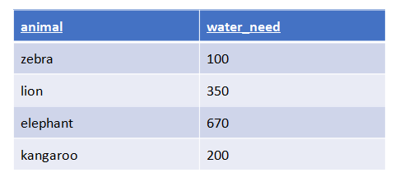
Data aggregation
Aggregation is the process of turning the values of a dataset (or a subset of it) into one single value. Let me make this clear! If you have a DataFrame like…
simple aggregation method is to calculate the summary of the water_needs, which is 100 + 350 + 670 + 200 = 1320. Or a different aggregation method would be to count the number of the animals, which is 4.

Slide 43
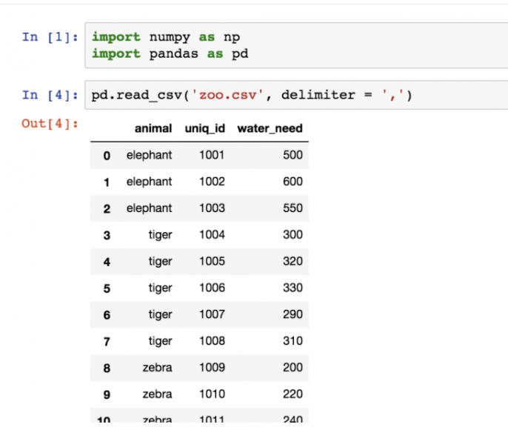
Data aggregation

Slide 44
Data aggregation
Pandas Data Aggregation : count()
Counting the number of the animals is as easy as applying a count function on the zoo dataframe:
zoo.count()
The .count() function counts the number of values in each column. In the case of the zoo dataset, there were 3 columns, and each of them had 22 values in it.
zoo[['animal']].count()
Or in this particular case, the result could be even nicer if you use this syntax:
zoo.animal.count()
This also selects only one column, but it turns our pandas dataframe object into a pandas series object. (Which means that the output format is slightly different.)

Slide 45
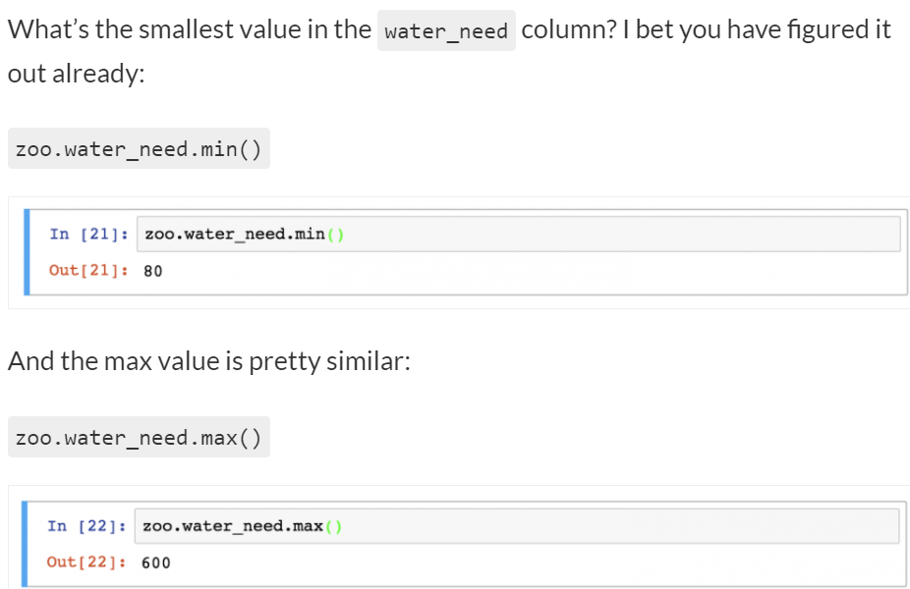
Data aggregation
Pandas Data Aggregation : sum()
Following the same logic, you can easily sum the values in the water_need column by typing:
zoo.water_need.sum()
Pandas Data Aggregation #3 and #4: .min() and .max()

Slide 46
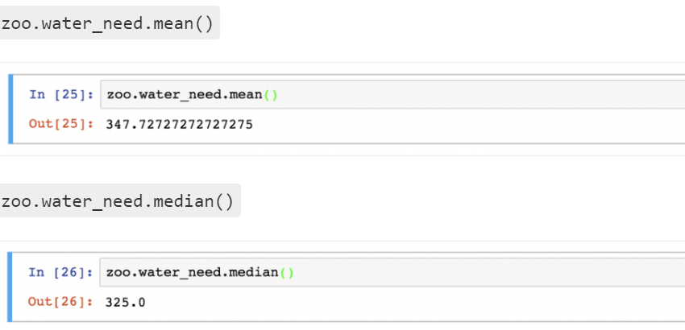
Data aggregation
Pandas Data aggregation ---mean() and median()

Slide 47
Pandas Read CSV
Read CSV Files
A simple way to store big data sets is to use CSV files (comma separated files).
CSV files contains plain text and is a well know format that can be read by everyone including Pandas.
In our examples we will be using a CSV file called 'data.csv'.
Download data.csv. or Open data.csv
Example
Load the CSV into a DataFrame:
import pandas as pd df = pd.read_csv('data.csv') print(df.to_string())

Slide 48
SciPy
SciPy, pronounced as Sigh Pi, is a scientific python open source, distributed under the BSD licensed library to perform Mathematical, Scientific and Engineering Computations.
The SciPy library depends on NumPy, which provides convenient and fast N-dimensional array manipulation.
The SciPy library is built to work with NumPy arrays and provides many user-friendly and efficient numerical practices such as routines for numerical integration and optimization.
Together, they run on all popular operating systems, are quick to install and are free of charge.
NumPy and SciPy are easy to use, but powerful enough to depend on by some of the world's leading scientists and engineers.

Slide 49
SciPy Sub-packages
scipy.cluster | Vector quantization / Kmeans
scipy.constants | Physical and mathematical constants
scipy.fftpack | Fourier transform
scipy.integrate | Integration routines
scipy.interpolate | Interpolation
scipy.io | Data input and output
scipy.linalg | Linear algebra routines
scipy.ndimage | n-dimensional image package
scipy.odr | Orthogonal distance regression
scipy.optimize | Optimization
scipy.signal | Signal processing
scipy.sparse | Sparse matrices
scipy.spatial | Spatial data structures and algorithms
scipy.special | Any special mathematical functions
scipy.stats | Statistics

Slide 50
SciPy - Basic Functionality
By default, all the NumPy functions have been available through the SciPy namespace.
There is no need to import the NumPy functions explicitly, when SciPy is imported.
The main object of NumPy is the homogeneous multidimensional array.
It is a table of elements (usually numbers), all of the same type, indexed by a tuple of positive integers.
In NumPy, dimensions are called as axes. The number of axes is called as rank.

Slide 51
SciPy - Basic Functionality
NumPy Vector
A Vector can be created in multiple ways. Some of them are described below.
Converting Python array-like objects to NumPy
Let us consider the following example.
import numpy as np
list = [1,2,3,4]
arr = np.array(list)
print (arr)

Slide 52
SciPy - Basic Functionality
Intrinsic NumPy Array Creation
NumPy has built-in functions for creating arrays from scratch. Some of these functions are explained below.
Using zeros()
The zeros(shape) function will create an array filled with 0 values with the specified shape. The default dtype is float64. Let us consider the following example.
import numpy as np
print np.zeros((2, 3))

Slide 53
SciPy - Basic Functionality
Using ones()
The ones(shape) function will create an array filled with 1 values. It is identical to zeros in all the other respects. Let us consider the following example.
import numpy as np
print np.ones((2, 3))
Using arange()
The arange() function will create arrays with regularly incrementing values. Let us consider the following example.
import numpy as np
print np.arange(7)

Slide 54
SciPy - Basic Functionality
Defining the data type of the values
Let us consider the following example.
import numpy as np
arr = np.arange(2, 10, dtype = np.float)
print (arr)
print ("Array Data Type :",arr.dtype)
Using linspace()
The linspace() function will create arrays with a specified number of elements, which will be spaced equally between the specified beginning and end values. Let us consider the following example.
import numpy as np
print np.linspace(1., 4., 6)

Slide 55
SciPy - Basic Functionality
Matrix
A matrix is a specialized 2-D array that retains its 2-D nature through operations. It has certain special operators, such as * (matrix multiplication) and ** (matrix power). Let us consider the following example.
import numpy as np
print np.matrix('1 2; 3 4’)
Conjugate Transpose of Matrix
This feature returns the (complex) conjugate transpose of self. Let us consider the following example.
import numpy as np
mat = np.matrix('1 2; 3 4')
print mat.H

Slide 56
SciPy - Basic Functionality
Transpose of Matrix
This feature returns the transpose of self. Let us consider the following example.
import numpy as np
mat = np.matrix('1 2; 3 4')
mat.T

Slide 57
Matplotlib
Python Matplotlib is a library which basically serves the purpose of Data Visualization.
The building blocks of Matplotlib library is 2-D NumPy Arrays.
In order to use the Matplotlib library for data visualization, we need to install it through pip command.
pip install matplotlib
we need to import this library whenever we wish to use its built-in functions.
from matplotlib import pyplot
matplotlib.pyplot is basically an interface which is used to add style functions to the graphs, charts, etc created using Matplotlib package.

Slide 58
Matplotlib
Python Matplotlib offers various types of charts to represent and visualize the data.
The following types of graphs/charts can be used to visualize the data using Python Matplotlib:
Line Plot
Scatter Plot
Histogram
Bar Chart
Pie Chart

Slide 59
Line Plot
we have used two Python lists (roll_num, marks) as the input data points.
pyplot.plot() function is used to plot the line representing the data. It accepts x-axis and y-axis values as parameters.
pyplot.show() function is used to display the plotted values by pyplot.plot() function.

Slide 60
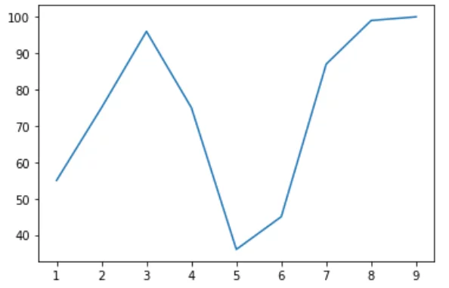
Line Plot
from matplotlib import pyplot
# x-axis values
roll_num = [1, 2, 3, 4, 5, 6, 7, 8, 9]
# y-axis values
marks = [55,75,96,75,36,45,87,99,100]
pyplot.plot(roll_num, marks)
pyplot.show()

Slide 61
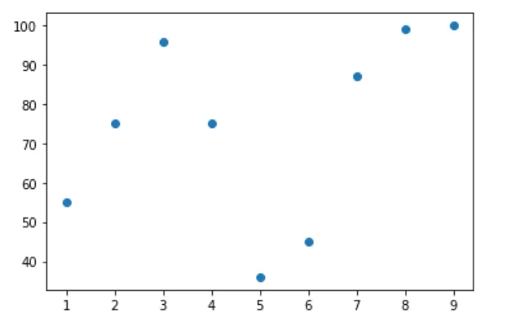
Scatter Plot
pyplot.scatter(x-axis, y-axis) is used to plot the data in a scattered fashion.
from matplotlib import pyplot
# x-axis values
roll_num = [1, 2, 3, 4, 5, 6, 7, 8, 9]
# y-axis values
marks = [55,75,96,75,36,45,87,99,100]
pyplot.scatter(roll_num, marks)
pyplot.show()

Slide 62
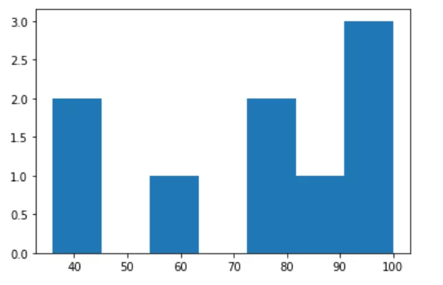
Histogram
pyplot.hist() function is used to represent the data points through a Histogram. It accepts two parameters:
List of the data to be plotted
Number of ranges(bins) to divide and display the data.
pyplot.hist() accepts a parameter bin which basically represents the number of divisions to distribute and display the input list values (data).
from matplotlib import pyplot
marks = [55,75,96,75,36,45,87,99,100]
pyplot.hist(marks, bins = 7)
pyplot.show()

Slide 63
Bar Charts
pyplot.bar() function represents the data in the form of rectangular bars. This function accepts a parameter y-val which are the scalar values to represent the x co-ordinates. The parameter align is used to set the bar plot values to either left/ right/ center.
pyplot.xticks() is used to set the tick locations for x-axis.
pyplot.ylabel() is used to set a label-text value to the data of y-axis.
pyplot.title()sets a title value to the Bar Chart.

Slide 64
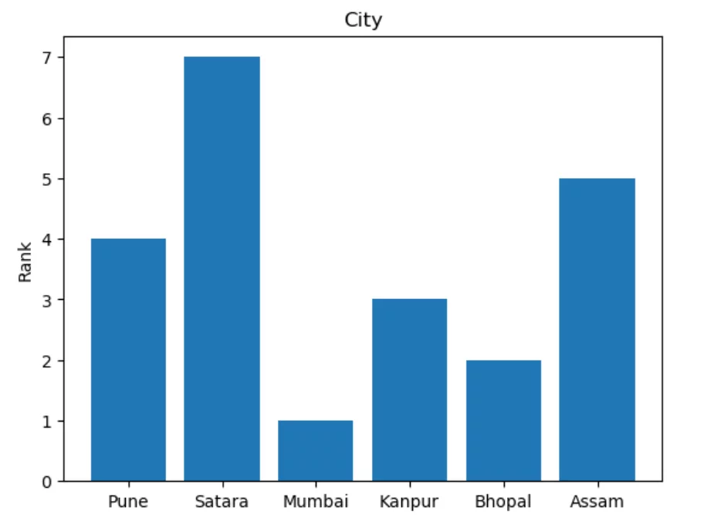
Bar Charts
import numpy as np
import matplotlib.pyplot
city = ('Pune', 'Satara', 'Mumbai', 'Kanpur', 'Bhopal', 'Assam')
y_val = np.arange(len(city))
rank = [4, 7, 1, 3, 2, 5]
pyplot.bar(y_val, rank, align='center')
pyplot.xticks(y_val, city)
pyplot.ylabel('Rank')
pyplot.title('City')
pyplot.show()

Slide 65
Pie Charts
pyplot.pie() function is used to represent the data in the form of a pie chart.
These parameters of pyplot.pie() serve the following functions:
explode: provides a scalar value to set a fraction of the pie chart apart.
labels: provides text values to represent each fraction of the chart.
colors: provides the colors to set to each fraction of the chart.
autopct: labels the wedges or the fractions of the chart with a numeric value.
shadow: Accepts boolean values. If set to TRUE, it creates shadow beneath the fractions of the pie chart.
startangle: rotates the start of the chart by a particular degree from x-axis.
pyplot.axis('equal') function enables equal scaling and creates scaled circle

Slide 66
Pie Charts
import numpy as np
import matplotlib.pyplot
city = ('Pune', 'Satara', 'Mumbai', 'Kanpur', 'Bhopal', 'Assam')
rank = [4, 7, 1, 3, 2, 5]
explode = (0.2, 0, 0, 0, 0, 0)
colors = ['yellowgreen', 'pink', 'purple', 'grey', 'red', 'orange']
pyplot.pie(rank, explode=explode, labels=city, colors=colors,
autopct='%1.1f%%', shadow=True, startangle=120)
pyplot.axis('equal')
pyplot.show()

Slide 67
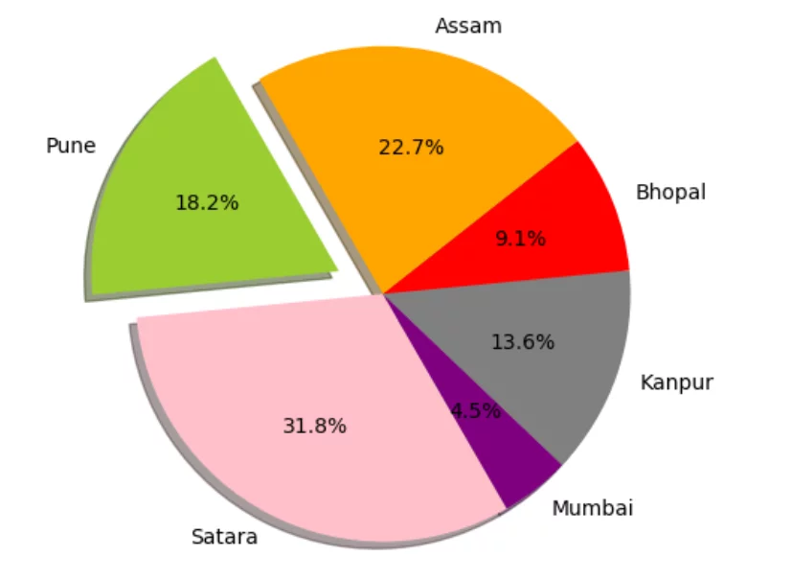
Pie Charts

Slide 68
Stacked Bar Charts
This is an example of creating a stacked bar plot with error bars using bar. Note the parameters yerr used for error bars, and bottom to stack the women's bars on top of the men's bars.
import matplotlib.pyplot as plt
labels = ['G1', 'G2', 'G3', 'G4', 'G5']
men_means = [20, 35, 30, 35, 27]
women_means = [25, 32, 34, 20, 25]
men_std = [2, 3, 4, 1, 2]
women_std = [3, 5, 2, 3, 3]
width = 0.35 # the width of the bars: can also be len(x) sequence

Slide 69
Stacked Bar Charts
fig, ax = plt.subplots()
ax.bar(labels, men_means, width, yerr=men_std, label='Men')
ax.bar(labels, women_means, width, yerr=women_std, bottom=men_means,
label='Women')
ax.set_ylabel('Scores')
ax.set_title('Scores by group and gender')
ax.legend()
plt.show()

Slide 70
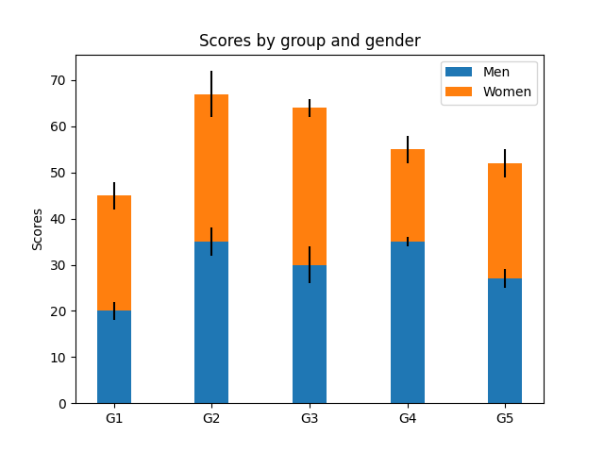
Stacked Bar Charts

Slide 71
Seaborn
Python Seaborn module serves the purpose of Data Visualization at an ease with higher efficiency.
In order to represent the variations in a huge data set, data visualization is considered as the best way to depict and analyze the data.
Seaborn stands out to have a better set of functions to carry out data visualization than Matplotlib in an optimized and efficient manner.
It supports NumPy and Pandas data structure to represent the data sets.

Slide 72
Seaborn
In order to get started with the functionalities of Seaborn module, we need to install the module in our environment using the below command:
pip install Seaborn
Seaborn module requires the following modules installed to work in a smooth manner:
Matplotlib
NumPy
Pandas
SciPy

Slide 73
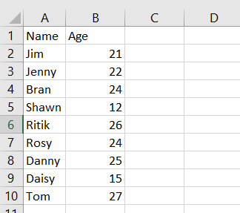
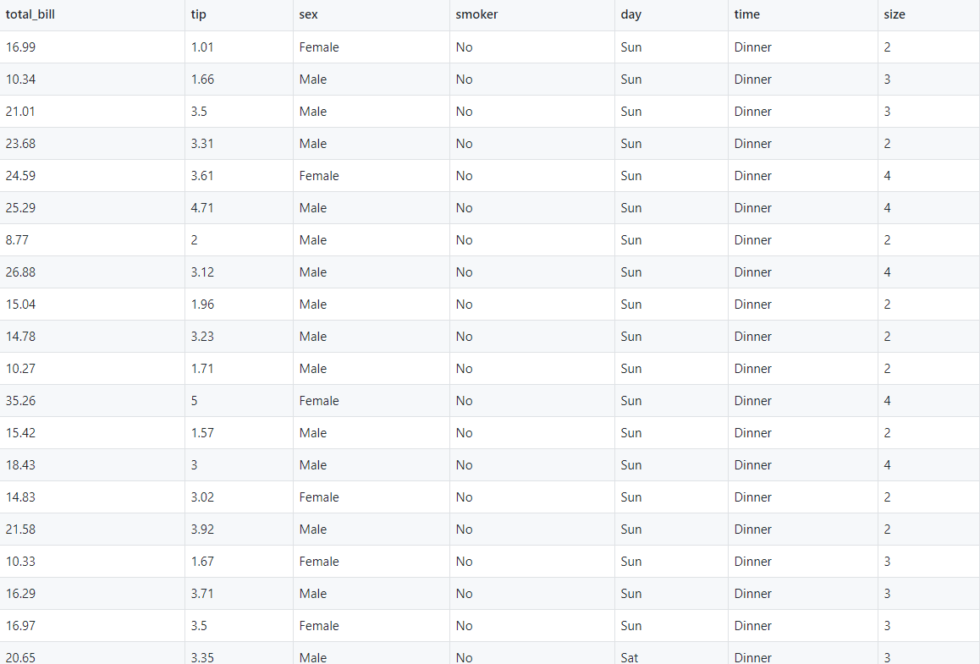
Seaborn
Data Files Used Throughout the Topic
Book1.CSV AND tips.csv

Slide 74
Seaborn
Statistical Analysis
Statistical Analysis is the basic estimation out of some parameters of the data-set to a large extent. Data Visualization can be considered as the best way to perform statistical analysis i.e. predict the outcome or the cause based on diagrammatic values.
Either of the following ways can be taken into consideration during the statistical analysis:
seaborn.scatterplot()
seaborn.lineplot()

Slide 75
Seaborn
seaborn.scatterplot()
The seaborn.scatterplot() function is basically used to depict the relationship between the parameters on the given axes respectively. Every point on the graph depicts a value corresponding to it.
Syntax:
seaborn.scatterplot(x=value, y=value, data=data)
Example:
import seaborn
import pandas
import matplotlib.pyplot as plt
csv = pandas.read_csv(r'C:\Book1.csv')
res = seaborn.scatterplot(x="Name", y="Age", data=csv)
plt.show()

Slide 76
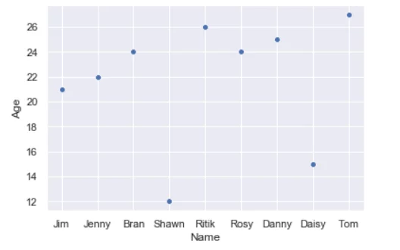
Seaborn
In the above example, we have imported Python Pandas module in order to use the read_csv() function to read the contents of the data set.
The column-‘Name’ is represented by the x-axis and the column-‘Age’ by the y-axis.

Slide 77
Seaborn
seaborn.lineplot()
The seaborn.lineplot() function can be extensively used in situations wherein we feel the need to check the dependency of a parameter on the other in a continuous manner relative to time.
Syntax:
seabron.lineplot(x=value, y=value, data=data)
Example:
import seaborn
import pandas
import matplotlib.pyplot as plt
csv = pandas.read_csv(r'C:\Book1.csv')
res = seaborn.lineplot(x="Name", y="Age", data=csv)
plt.show()

Slide 78
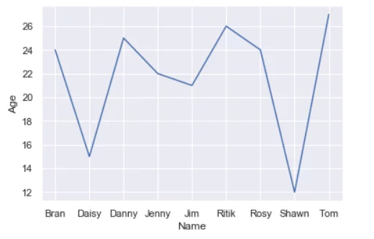
Seaborn

Slide 79
Categorical Scatter Plot
Categorical data divides and represents itself in the form of discrete groups i.e. a subset of the original data.
Python Seaborn module contains the following methods to represent and visualize categorical data:
seaborn.catplot()
seaborn.stripplot()
seaborn.swarmplot()

Slide 80
Categorical Scatter Plot
seaborn.catplot()
The seaborn.catplot() function, as mentioned above, is one of the techniques to analyze the relationship between a numeric value and a categorical group of values together.
Syntax:
seaborn.catplot(x=value, y=value, data=data)
Example:
import seaborn
import pandas
import matplotlib.pyplot as plt
csv = seaborn.load_dataset("tips")
res = seaborn.catplot(x="tip", y="sex", data=csv)
plt.show()

Slide 81
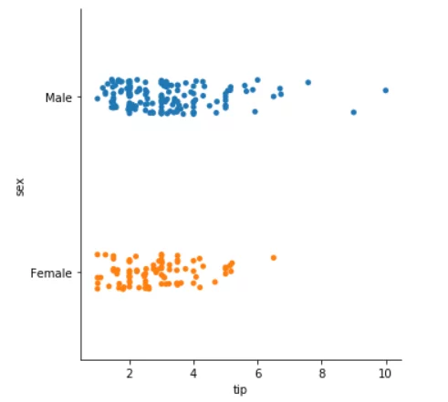
Categorical Scatter Plot

Slide 82
Categorical Scatter Plot
seaborn.stripplot()
The seaborn.stripplot() function considers one of the input columns as categorical data input and then it plots the points accordingly in an ordinal fashion despite the different data type of the input.
Syntax:
seaborn.stripplot(x=value, y=value, data=data)
Example:
import seaborn
import pandas
import matplotlib.pyplot as plt
csv = seaborn.load_dataset("tips")
res = seaborn.stripplot(x="tip", y="sex", data=csv,jitter=0.05)
plt.show()

Slide 83
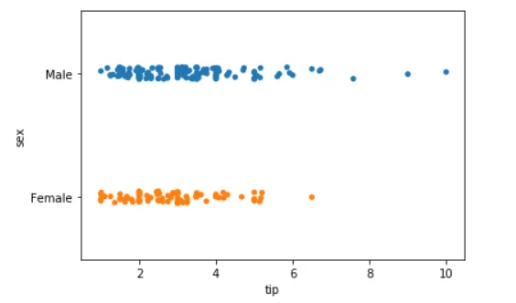
Categorical Scatter Plot
The parameter jitter is useful when the data set consists of data points that overlap. In such cases, setting a jitter value can help them get uniformly distributed.

Slide 84
Categorical Scatter Plot
seaborn.swarmplot()
The seaborn.swarmplot() function resembles the seaborn.stripplot() function with a slight difference. The seaborn.swarmplot() function plots the data values along the categorical axis chosen. Thus, it completely avoids overlapping.
Syntax: seaborn.swarmplot(x=value, y=value, data=data)
Example:
import seaborn
import pandas
import matplotlib.pyplot as plt
csv = seaborn.load_dataset("tips")
res = seaborn.swarmplot(x="tip", y="sex", data=csv)
plt.show()

Slide 85
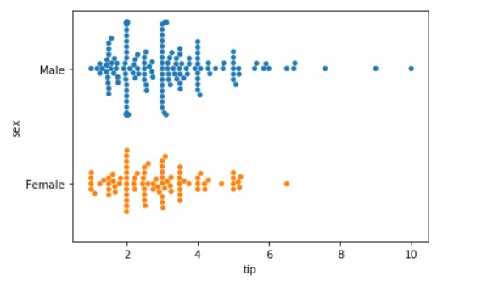
Categorical Scatter Plot
In the above example, I have passed the column ‘sex’ as the only categorical data and have plotted against the same along the x-axis, respectively.

Slide 86
Categorical Distribution Plot
Categorical Distribution data basically refers to the type of data wherein the result describes the certain possibility of the random/chosen variable to belong to one of the given possible categories.
Python Seaborn has the following functions to represent the categorical distributed data efficiently:
seaborn.violinplot()
seaborn.boxplot()
seaborn.boxenplot()

Slide 87
Categorical Distribution Plot
seaborn.violinplot()
The seaborn.violinplot() function represents the underlying distribution of the data. It depicts and represents the distribution of data against different categorical data input.
Syntax:
seaborn.violinplot(x=value, y=value, data=data)
Example:
import seaborn
import pandas
import matplotlib.pyplot as plt
csv = pandas.read_csv("C:\\Book1.csv")
res = seaborn.violinplot(x=csv['Age'])
plt.show()

Slide 88
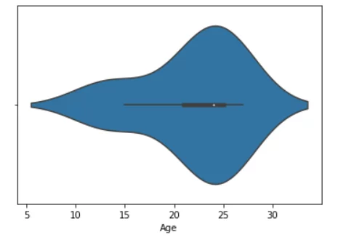
Categorical Distribution Plot
In the above example, we have considered the distribution of data along the column-‘Age’, respectively.

Slide 89
Categorical Distribution Plot
seaborn.boxplot()
The seaborn.boxplot() function represents the categorical distribution of data and sets comparison among the different categorical data inputs.
The ‘box’ structure represents the main quartile of the data input while the ‘line’ structure represents the rest of the distribution of data. The outliers are represented by points using an inter-quartile function.
Syntax:
seaborn.boxplot(x=value, y=value, data=data)

Slide 90
Categorical Distribution Plot
Example:
import seaborn
import pandas
import matplotlib.pyplot as plt
csv = pandas.read_csv("C:\\Book1.csv")
res = seaborn.boxplot(x=csv['Age'])
plt.show()
In the above example, we have used Book1.csv file as the input data set.
If you try to analyze the data-set, you will find the Age-12 to be an outlier type of data and the rest of the data ranging between 15-27. This is represented well by the seaborn.boxplot() function.

Slide 91
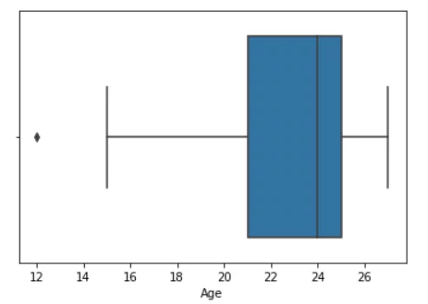
Categorical Distribution Plot

Slide 92
Categorical Distribution Plot
seaborn.boxenplot()
The seaborn.boxenplot() function is quite similar to seaborn.boxplot() function with a slight difference in the representation.
The seaborn.boxenplot() function represents the distribution of the categorical data in a way where the large quartiles represent the features corresponding to the actual data observations.
It presents the data in a format that gives us a detailed information in a visualized form about the entire distribution of data.
Syntax:
seaborn.boxenplot(x=value, y=value, data=data)

Slide 93
Categorical Distribution Plot
Example:
import seaborn
import pandas
import matplotlib.pyplot as plt
csv = pandas.read_csv("C:\\Book1.csv")
res = seaborn.boxenplot(x=csv['Age'])
plt.show()

Slide 94
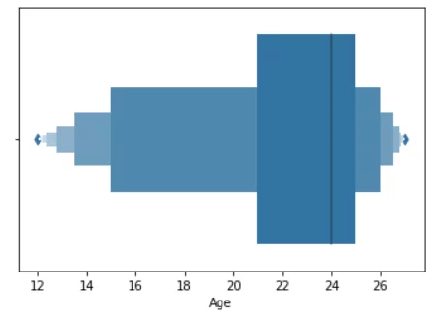
Categorical Distribution Plot
If you analyze and compare the below output with the input data set, it is clearly understood that boxenplot represents the entire distribution of the data points ranging between 12-27, along with the distribution of the categorical data with a large quartile-box structure.

Slide 95
Categorical Estimate Plot
The estimation of categorical data basically refers to the representation of certain estimation or prediction of the categorical data values to the corresponding data variable.
Python Seaborn has the following functions to be used for the estimation of categorical data:
seaborn.countplot()
seaborn.barplot()
seaborn.pointplot()

Slide 96
Categorical Estimate Plot
seaborn.countplot()
The seaborn.counplot() function is used to estimate and represent the categorical variable in terms of the frequency or count of it.
Syntax:
seaborn.countplot(x=value, y=value, data=data)
Example:
import seaborn
import pandas
import matplotlib.pyplot as plt
csv = pandas.read_csv("C:\\Book1.csv")
res = seaborn.countplot(x=csv['Age'])
plt.show()

Slide 97
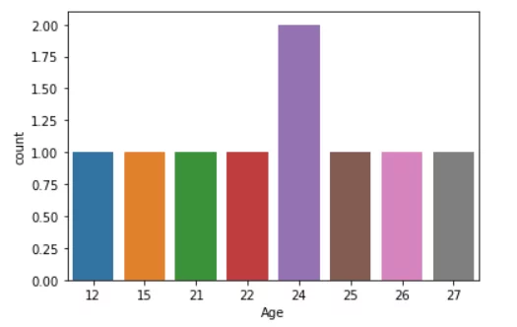
Categorical Estimate Plot
the countplot() function has basically counted the frequency of the input data field and represented it along the y-axis while the data field – ‘Age’ being represented along the x-axis.

Slide 98
Categorical Estimate Plot
seaborn.barplot()
The seaborn.barplot() function basically represents the estimated data in the form of the central tendency of the data representation.
Example:
import seaborn
import pandas
import matplotlib.pyplot as plt
csv = pandas.read_csv("C:\\Book1.csv")
res = seaborn.barplot(x=csv['Name'], y=csv['Age'])
plt.show()

Slide 99
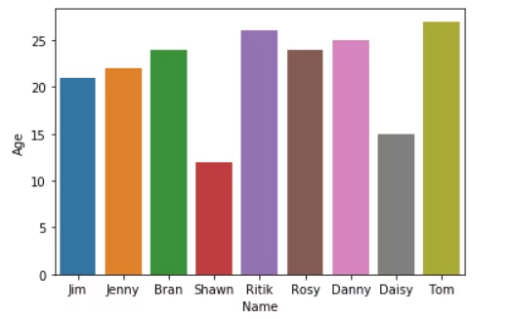
Categorical Estimate Plot

Slide 100
Categorical Estimate Plot
seaborn.pointplot()
The seaborn.pointplot() function represents the estimation of the central tendency of the distribution with the help of scatter points and lines joining them.
Syntax:
seaborn.pointplot(x=value, y=value, data=data)
Example:
import seaborn
import pandas
import matplotlib.pyplot as plt
csv = pandas.read_csv("C:\\Book1.csv")
res = seaborn.pointplot(x=csv['Name'], y=csv['Age'])
plt.show()

Slide 101
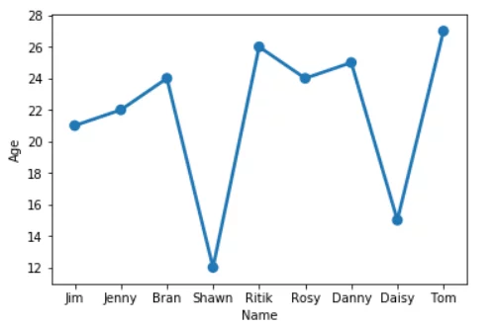
Categorical Estimate Plot

Slide 102
Video Links/You Tube Links
https://www.youtube.com/watch?v=GB9ByFAIAH4
https://www.youtube.com/watch?v=RhEjmHeDNoA
https://www.youtube.com/watch?v=ZB7BZMhfPgk
https://www.youtube.com/watch?v=yZTBMMdPOww
NPTEL LINK
https://www.youtube.com/watch?v=tA42nHmmEKw&list=PLh2mXjKcTPSACrQxPM2_1Ojus5HX88ht7
https://www.youtube.com/watch?v=oHaYdfWlgCg&list=PLh2mXjKcTPSACrQxPM2_1Ojus5HX88ht7&index=12

Slide 103
Daily Quiz
1. The plot method on Series and DataFrame is just a simple wrapper around ____________ a) gplt.plot() b) plt.plot() c) plt.plotgraph() d) none of the mentioned
Answer: b
2. Point out the correct combination with regards to kind keyword for graph plotting. a) ‘hist’ for histogram b) ‘box’ for boxplot c) ‘area’ for area plots d) all of the mentioned
Answer: d

Slide 104
Daily Quiz
3.Which is a python package used for 2D graphics?
A. matplotlib.pyplot
B. matplotlib.pip
C. matplotlib.numpy
D. matplotlib.plt
Answer : Option A
4.Identify the right type of chart using the following hints.
Hint 1: This chart is often used to visualize a trend in data over intervals of time.
Hint 2: The line in this type of chart is often drawn chronologically.
A. Line chart
B. Bar chart
C. Pie chart
D. Scatter plot
Answer : Option A

Slide 105
MCQs
5. Pandas key data structure is called? A. Keyframe B. DataFrame C. Statistics D. Econometrics
Answer – B
6. A panel is a ___ container of data A. 1D B. 2D C. 3D D. Infinite
Answer -C

Slide 106
MCQs
7. SciPy stands for? A. science library B. source library C. significant library D. scientific library
Answer –D
8. Which of the following is true?
A. By default, all the NumPy functions have been available through the SciPy namespace B. There is no need to import the NumPy functions explicitly, when SciPy is imported. C. SciPy is built on top of NumPy arrays D. All of the above
Answer -D

Slide 107
MCQs
9. NumPy is often used along with packages like? A. Node.js B. Matplotlib C. SciPy D. Both B and C
Answer –D
10. What will be output for the following code? import numpy as np
a = np.array([1,2,3])
print a
A. [[1, 2, 3]] B. [1] C. [1, 2, 3] D. Error
Answer-C

Slide 108
Weekly Assignment
Q-1 What do you mean by data visualization technique ,Also Explain how data visualization can help in decision making?
Q-2 Write steps to plot your data on a graph.
Q-3 Write code to do the following:
-Plot the following data on line chart:
Runs in Overs 10 20
MI 110 224
RCB 85 210

Slide 109
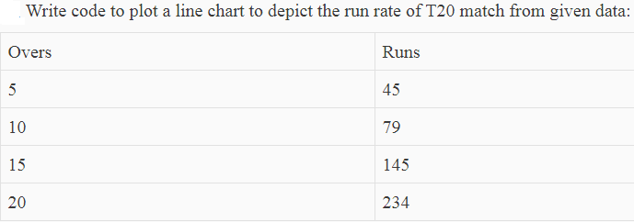
Weekly Assignment
Q-4Write code to plot a line chart to depict the run rate of T20 match from given data:

Slide 110
Weekly Assignment
5. Write a Pandas program to add, subtract, multiple and divide two Pandas Series.
6. Write a NumPy program to get the numpy version and show numpy build configuration.
7. How to check whether specified values are present in NumPy array?
8. Write a NumPy program to create a 3x3 matrix with values ranging from 2 to 10. ExpectedOutput: [[234] [567] [ 8 9 10]]

Slide 111
Old Question Papers
Not Applicable as this course has been introduced first time in the syllabus .

Slide 112
Expected Questions for University Exam
Q1.What does callable() describes?
Q2. Explain various ways of inspecting Python objects.
Q3. What are introspection tools? Explain them briefly.
Q4. Explain with example issubclass() and getattr() functions.
Q5. Explain inspect modules with example.
Q6. What should be the output of the following program? class Object(object): def __init__(self): pass class Wall(Object): def __init__(self): pass print(issubclass(Object, Object)) print(issubclass(Object, Wall)) print(issubclass(Wall, Object)) print(issubclass(Wall, Wall))

Slide 113
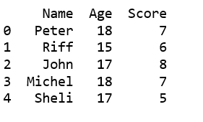
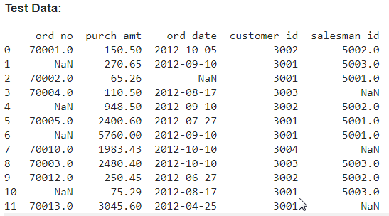
Expected Questions for University Exam
Q-7 Creating a Pandas dataframe using list of tuples.
Q-8 Write a Pandas program to detect missing values of a given DataFrame. Display True or False

Slide 114
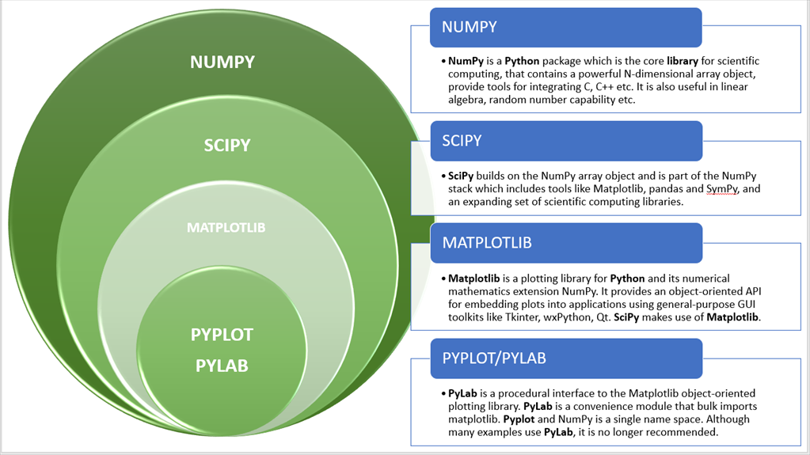
SUMMARY

Slide 115
TEXT & REFERENCE BOOKS
Text books:
(1) Magnus Lie Hetland, "Beginning Python-From Novice to Professional"—Third Edition, Apress
(2) Peter Morgan, Data Analysis from Scratch with Python, AI Sciences
(3) Allen B. Downey, “Think Python: How to Think Like a Computer Scientist”, 2nd edition, Updated for Python 3, Shroff/O‘Reilly Publishers, 2016
(4) Miguel Grinberg, Developing Web applications with python, OREILLY
Reference Books:
(1) Dusty Phillips, Python 3 Object-oriented Programming - Second Edition, O’Reilly
(2) Burkhard Meier, Python GUI Programming Cookbook - Third , Packt
(3) DOUG HELLMANN, THE PYTHON 3 STANDARD LIBRARY BY EXAMPLE, :Pyth 3 Stan Libr Exam _2 (Developer's Library) 1st Edition, Kindle Edition.
(4) Kenneth A. Lambert, ―Fundamentals of Python: First Programs‖, CENGAGE Learning, 2012.

Slide 116
THANK YOU!

